Slide 1
Physics Hierarchy and Tag List (Prepared by: Aman Kumar)

Slide 2
Format of Hierarchy and Tags (Created using Microsoft Visio)

Slide 4
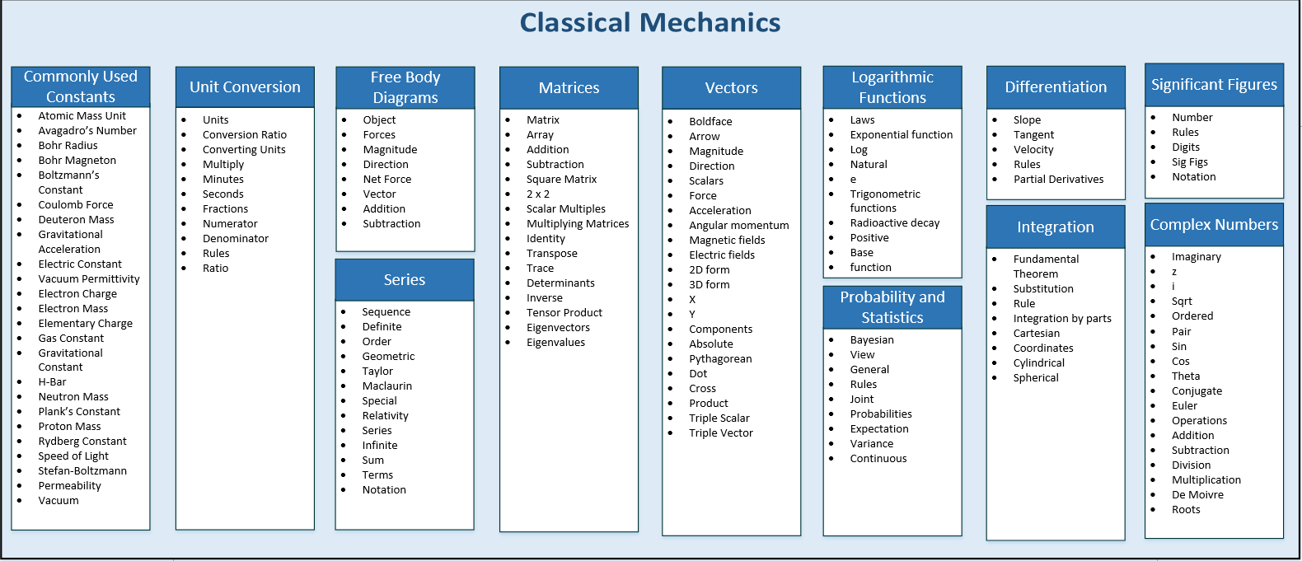

Slide 7
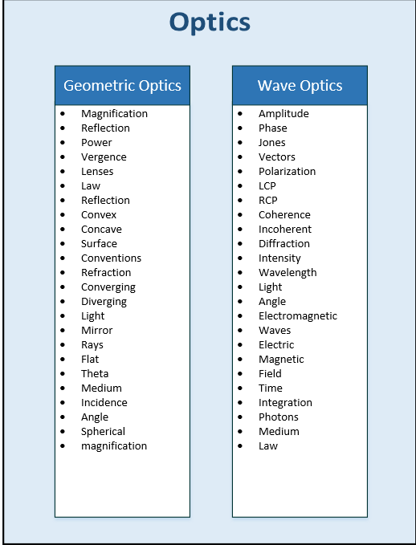

Slide 8
